Slide 1
The Endings Project
Concluding, Archiving, and Preserving Digital Projects
for Long-Term Usability
Presented by Dr. J. Matthew Huculak
Digital Scholarship Librarian
University of Victoria Libraries
huculak@uvic.ca | @jmhuculak

Slide 2
UVIC FAQs
(shameless plug of west coast summer)
Home of:
Digital Scholarship Commons at UVIC Libraries
Digital Humanities Summer Institute
Humanities Computing & Media Centre
Electronic Textual Cultures Lab

Slide 3
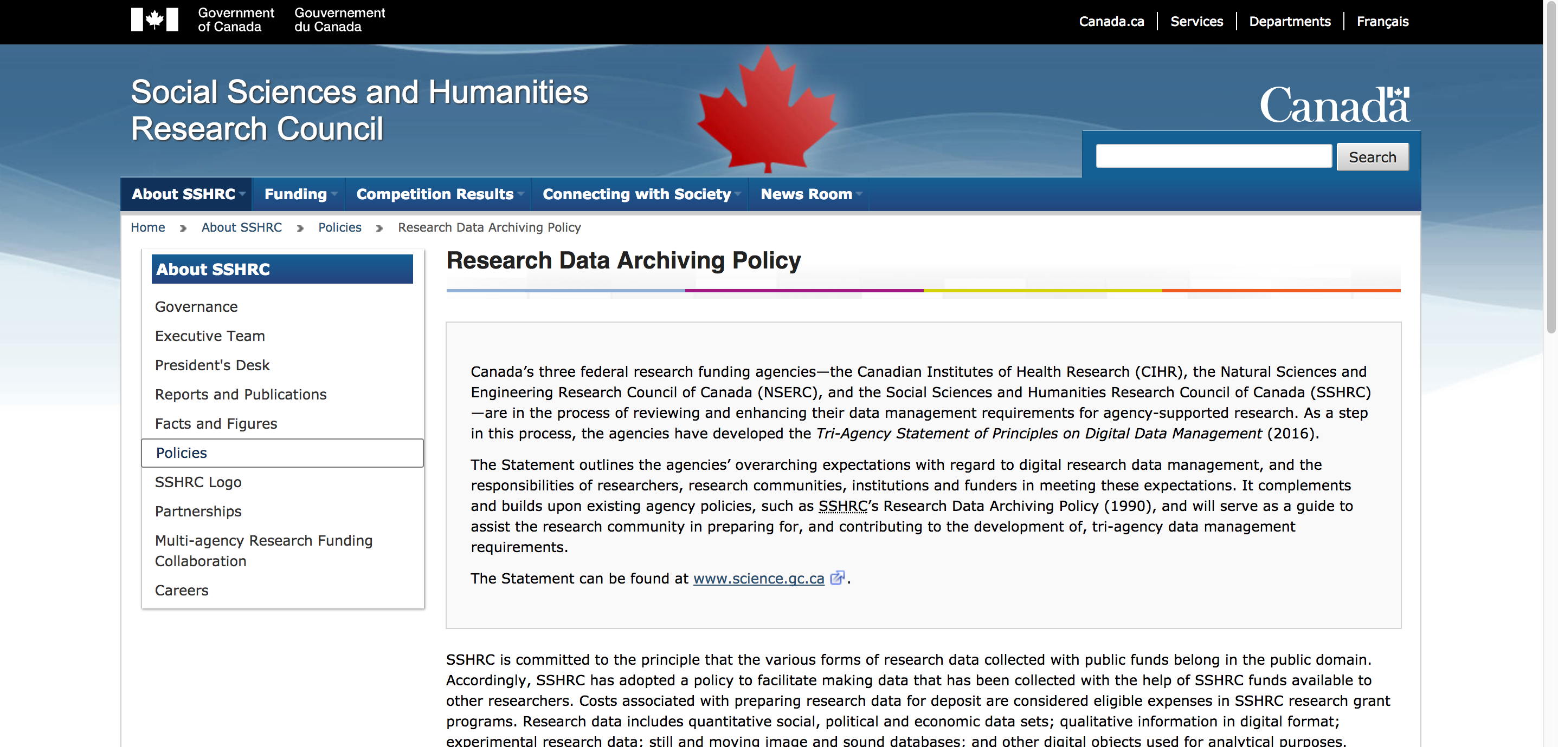
Preservation Mandate without Enforcement

Slide 4
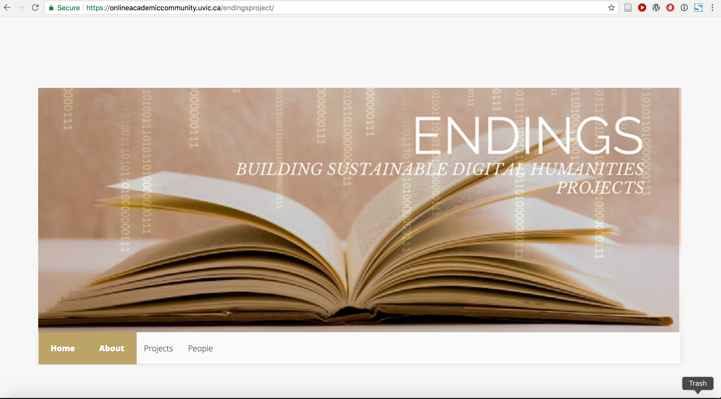
“Successful models for bringing projects to closure are rare, and models for truly sustainable preservation are few and far between.”

Slide 5
First Four Projects
The Robert Graves Diary Project, Directed by Elizabeth Grove-White http://graves.uvic.ca
The Nxa'amxcín Database and Dictionary, directed by Ewa Czaykowska-Higgins
Le Mariage sous l’Ancien Régime, directed by Claire Carlin http://mariage.uvic.ca/
The Map of Early Modern London, directed by Janelle Jenstad http://mapoflondon.uvic.ca/

Slide 6
Done: Finishing Projects in the Digital Humanities (dhq 3:2, 2009)
As opposed to archival or commercial agendas, research in DH must often deal with the loss of key personnel, economic constraints (lack of new funding for ongoing work), competition from similar projects, the evolution of standards, and technological change that affect the life of a project.
When is done?

Slide 7
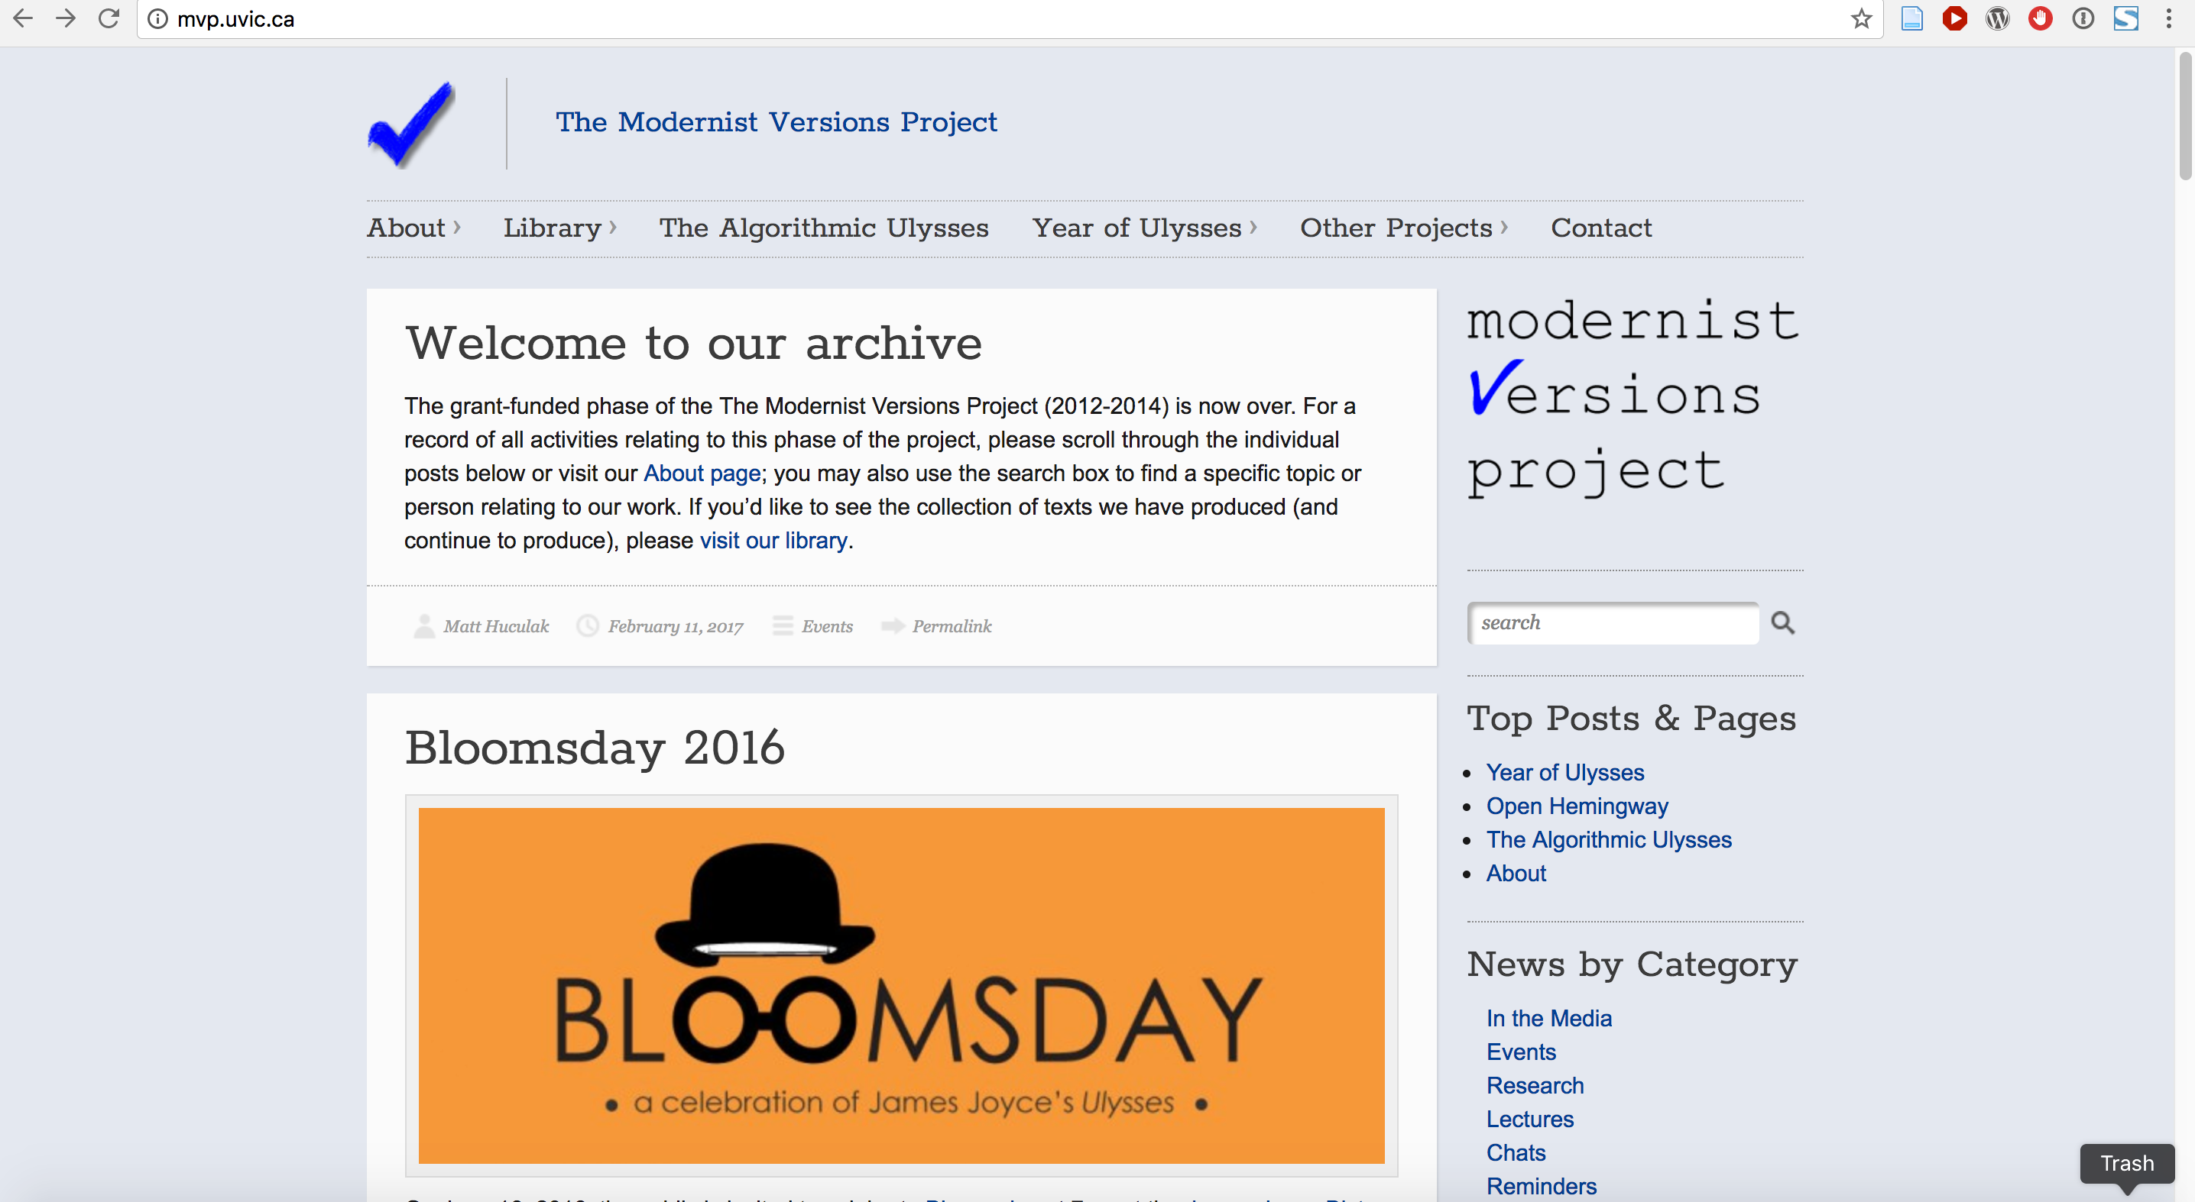
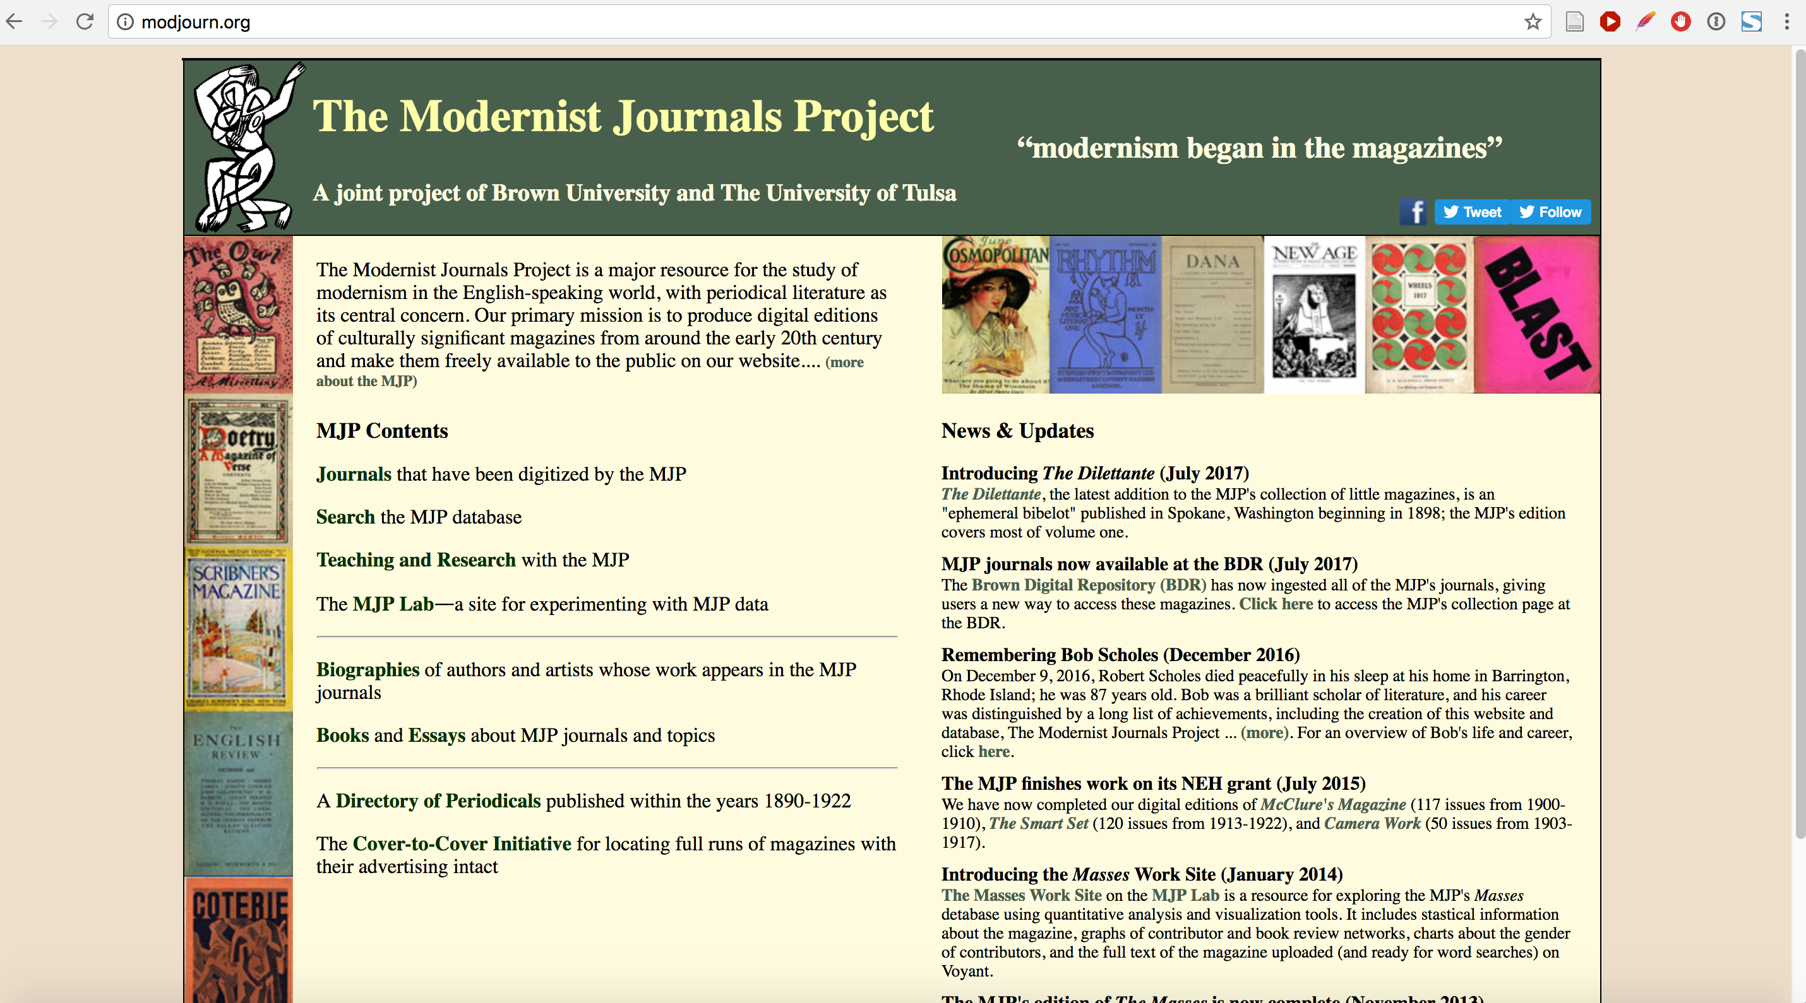
Different preservation strategies

Slide 8
Objectives of Grant
Objective 1: develop models for the closure of digital projects that will apply to a variety of digital research across humanities and social science disciplines; testing feasibility of models from other projects.
Objective 2: develop workable strategies for preserving digital projects, both content and applications, over the long term. Also will work alongside any other promising initiatives from the international digital humanities community to produce “Endings Compliance Framework”

Slide 9
Access is not recreation
“The true, though simple, story we tell ourselves in the digital humanities is that ensuring that a project uses an appropriate form of markup (like the TEI) for content is sufficient to preserve the work.”
“Access is not recreation, and over the long term the chances that someone can recreate the hardware and software platform on which an installation could work will approach zero. We are better off giving them something they can understand and re-implement, if needed, than something they can’t install.”
“Burying Dead Projects: Depositing the Globalization Compendium,” Geoffrey Rockwell et al.

Slide 10
Access is not recreation
This approach is difficult and time-consuming both for present archivers and future revivers of the system.
Solution needed that requires neither installation nor re-implementation because it simply works.

Slide 11
HTML5 and Staticizing
almost all of the current functionality which is dependent on server-side technologies such as XML databases can be reproduced using pure HTML5, CSS and JavaScript.
Once a project is over and the data is “frozen,” it makes perfect sense to “staticize” it.

Slide 12
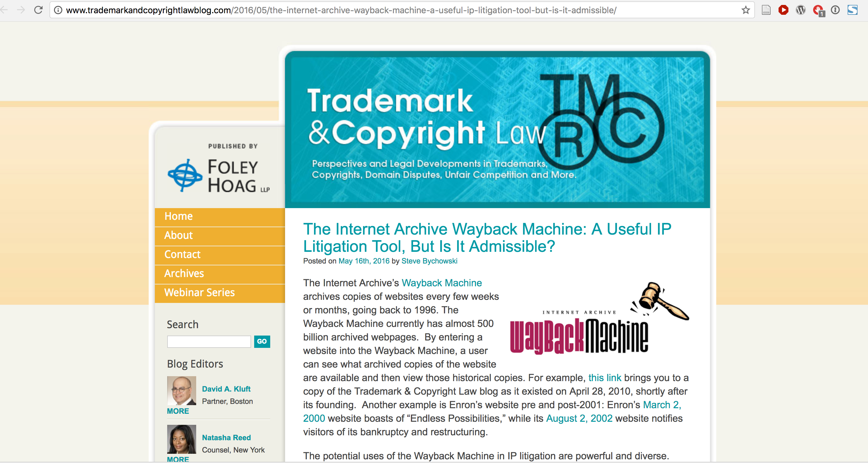
Archive-it & The Wayback Machine

Slide 13
Endings Collaborators
Library
Faculty PIs
HCMC
YOU!

Slide 14
Methodologies
Survey of DH project participants around the world
Build upon Ithaka S + R Sustainability Implementation Toolkit
The toolkit we will construct will provide strategies applicable across projects in DH, including methods for benchmarking various project plateaus, and other phased exit strategies leading to a predefined end point. (how to end)

Slide 15
History: Some Common Issues Among Four Text Projects
Issues in common among the four test projects:
what standards should be selected for archive formats;
how archives can support open access to materials (our preference), while restricting access to some project material which cannot be publicly released for licensing reasons;
how many metadata formats should be generated;
how items should be packaged for archival deposit;
which archives should be targeted (besides the UVic Library repository);
how static content will be generated;
how searching will be handled.

Slide 16
Role of the University Library
Kretzschmar and Potter argued in 2010 that “collaboration with the university library is the only realistic option for long-term sustainability of digital humanities projects in the current environment.”

Slide 17
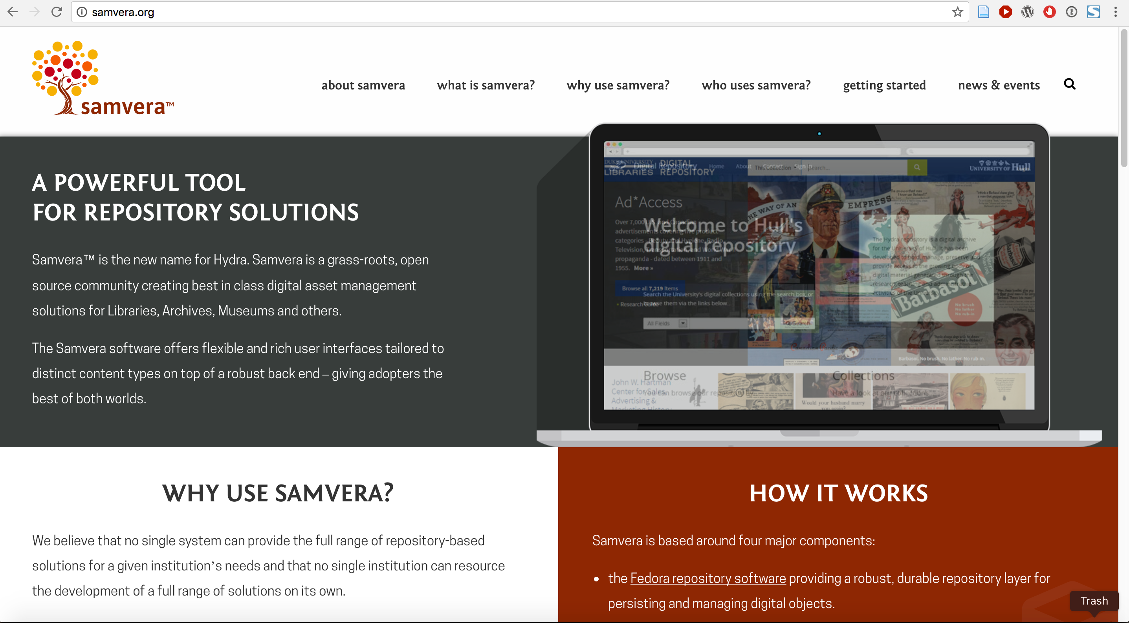
Digital Asset Management Systems

Slide 18
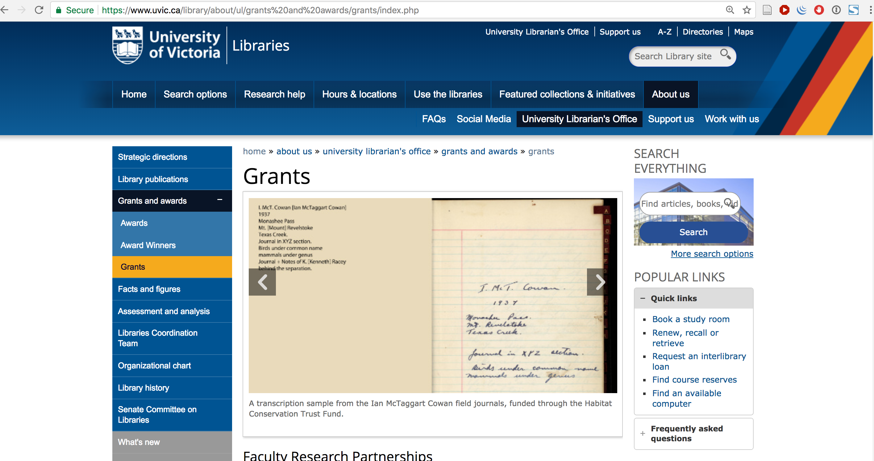
Grants Menu
Christine Walde, Grants Librarian

Slide 19
UVic Digital Project Life-Cycle
researcher
technical team
grant writers
library
long-term preservation team

Slide 20
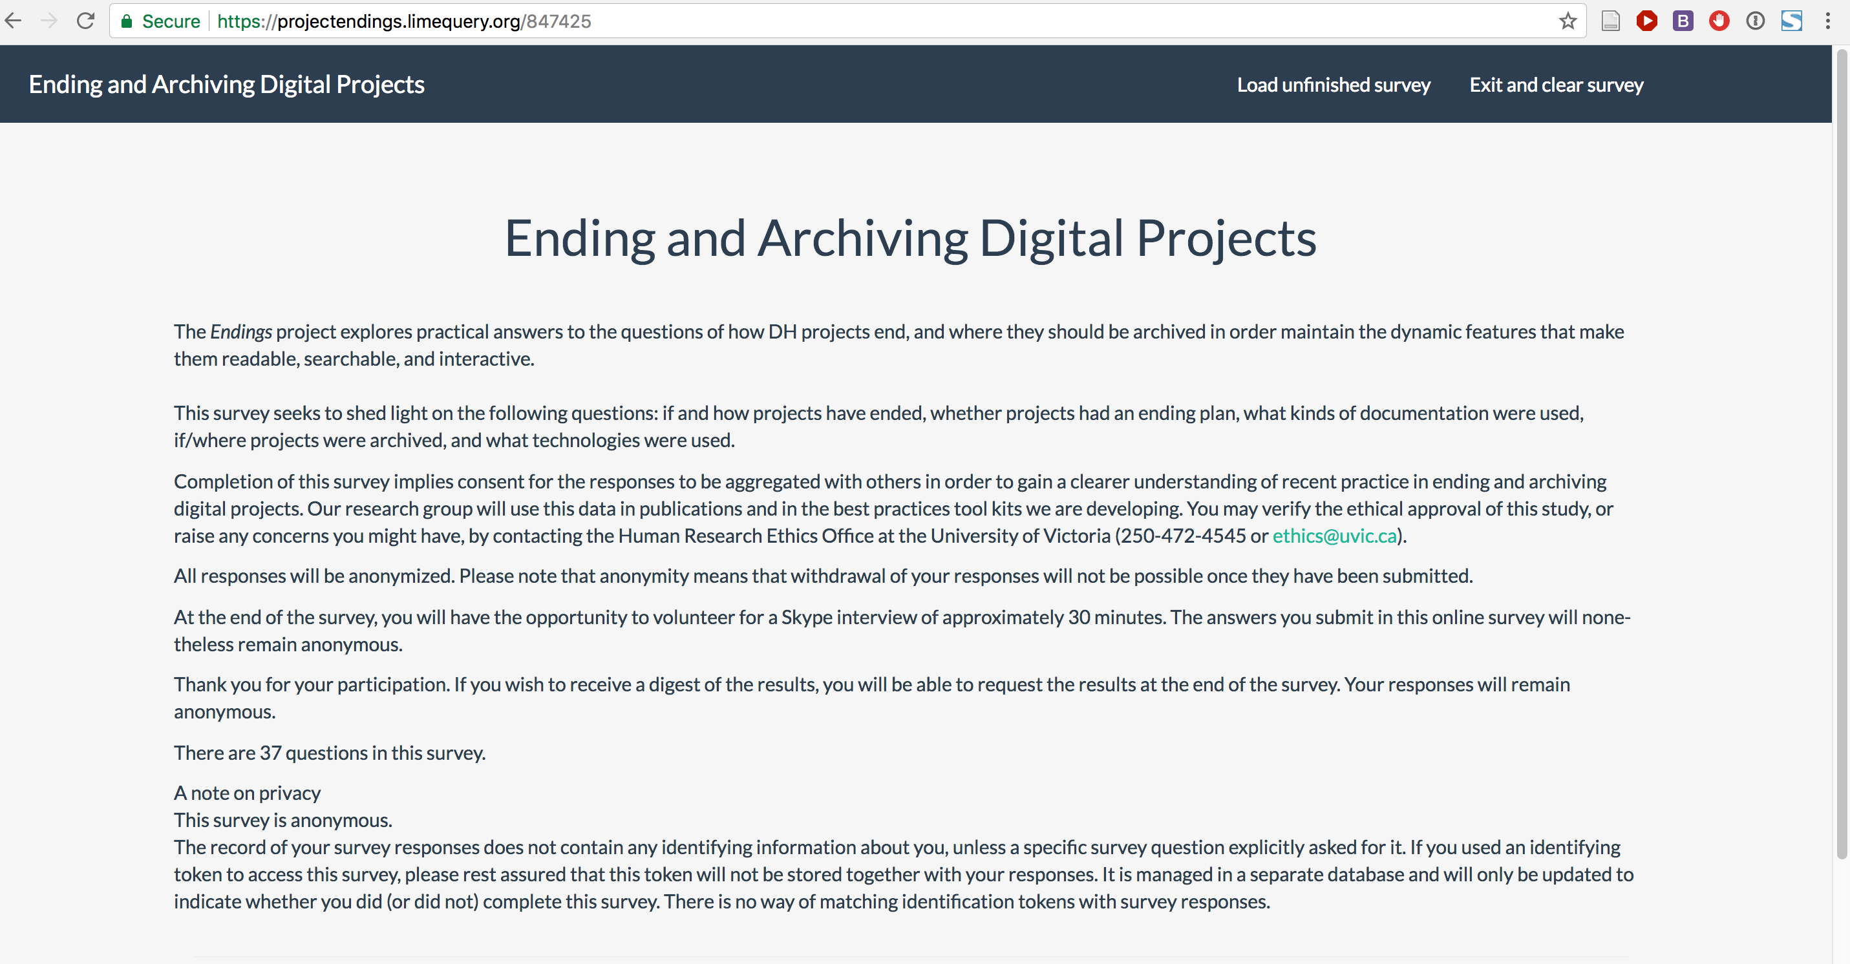
Endings Project Survey
http://bit.ly/endingsproject

Slide 21
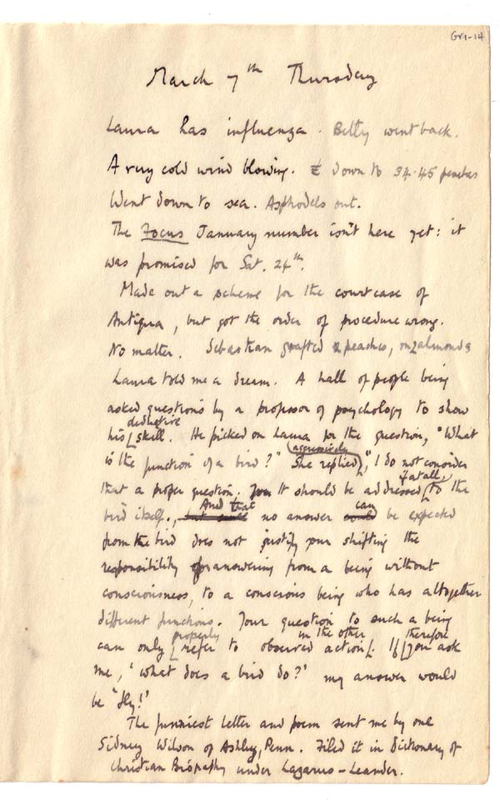
Robert Grave’s Diary
Martin Holmes & Stewart Arneil, HCMC

Slide 22
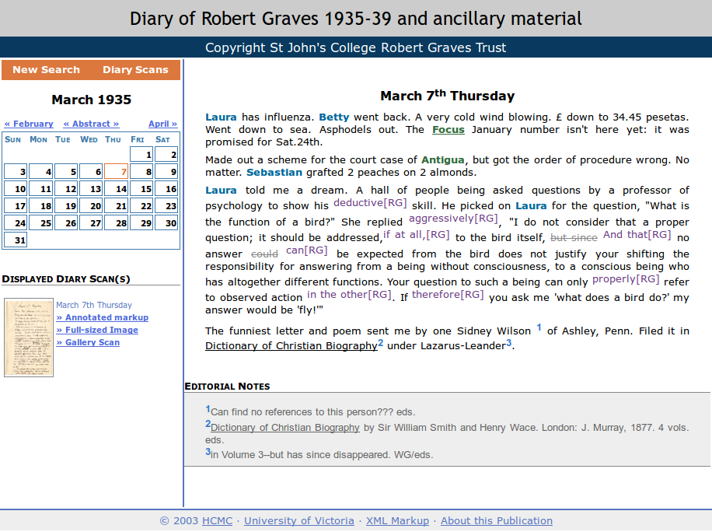
2003 Robert Grave’s Diary
Martin Holmes & Stewart Arneil, HCMC

Slide 23
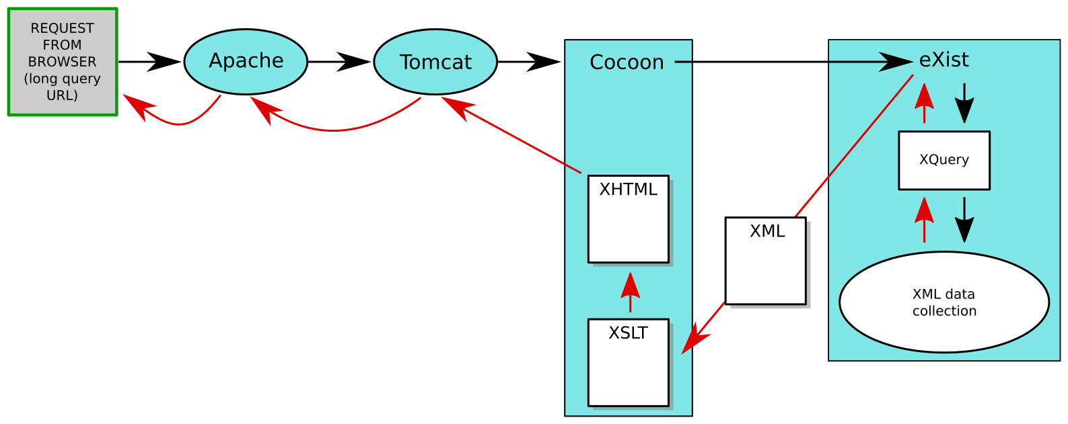
2003 Robert Grave’s Diary Application
Martin Holmes & Stewart Arneil, HCMC

Slide 24
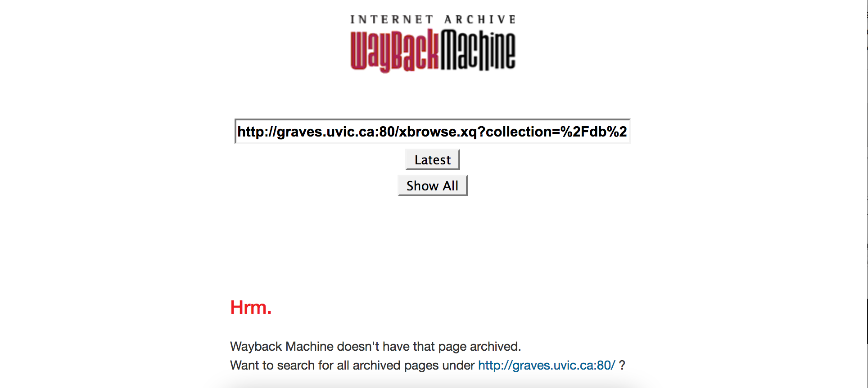
2003 Wayback Machine
Martin Holmes & Stewart Arneil, HCMC

Slide 25
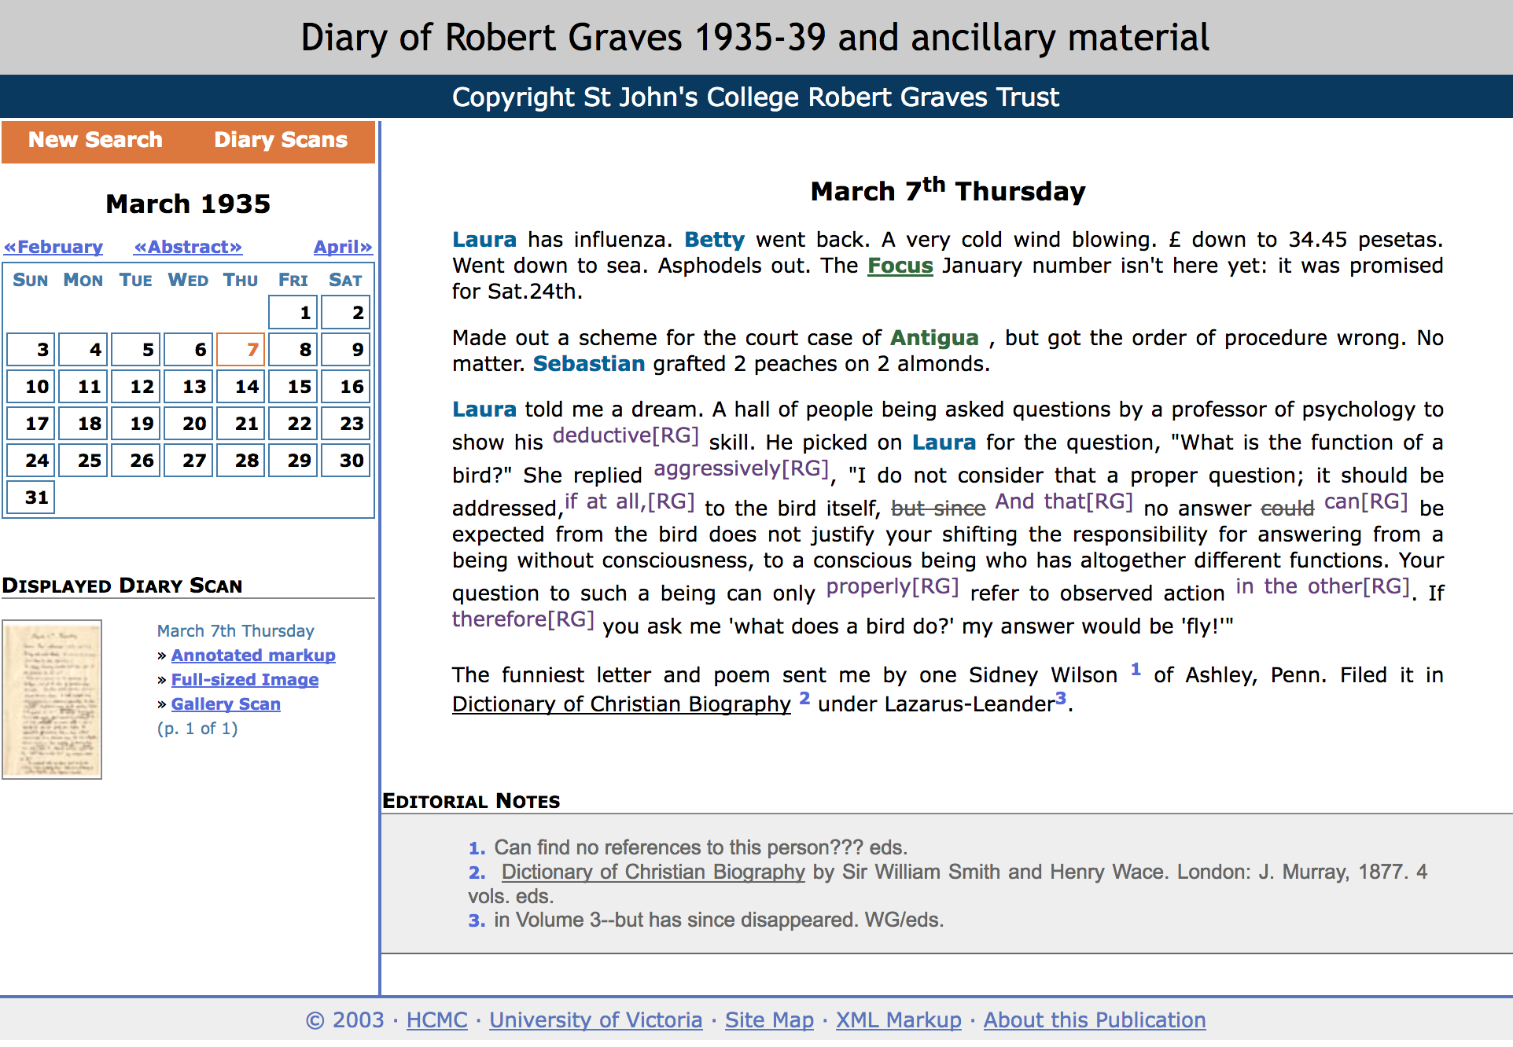
2016 Robert Grave’s Diary
Martin Holmes & Stewart Arneil, HCMC

Slide 26
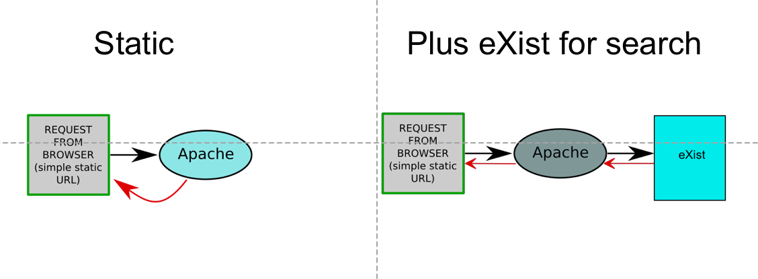
2016 Architecture
Martin Holmes & Stewart Arneil, HCMC

Slide 27
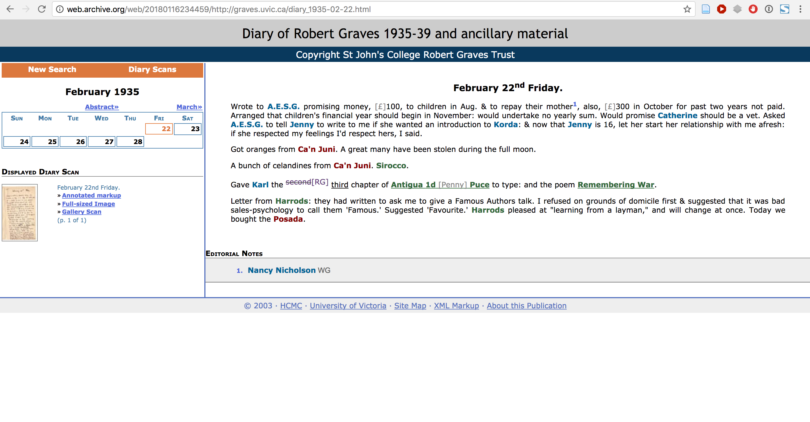
2018 Wayback

Slide 28
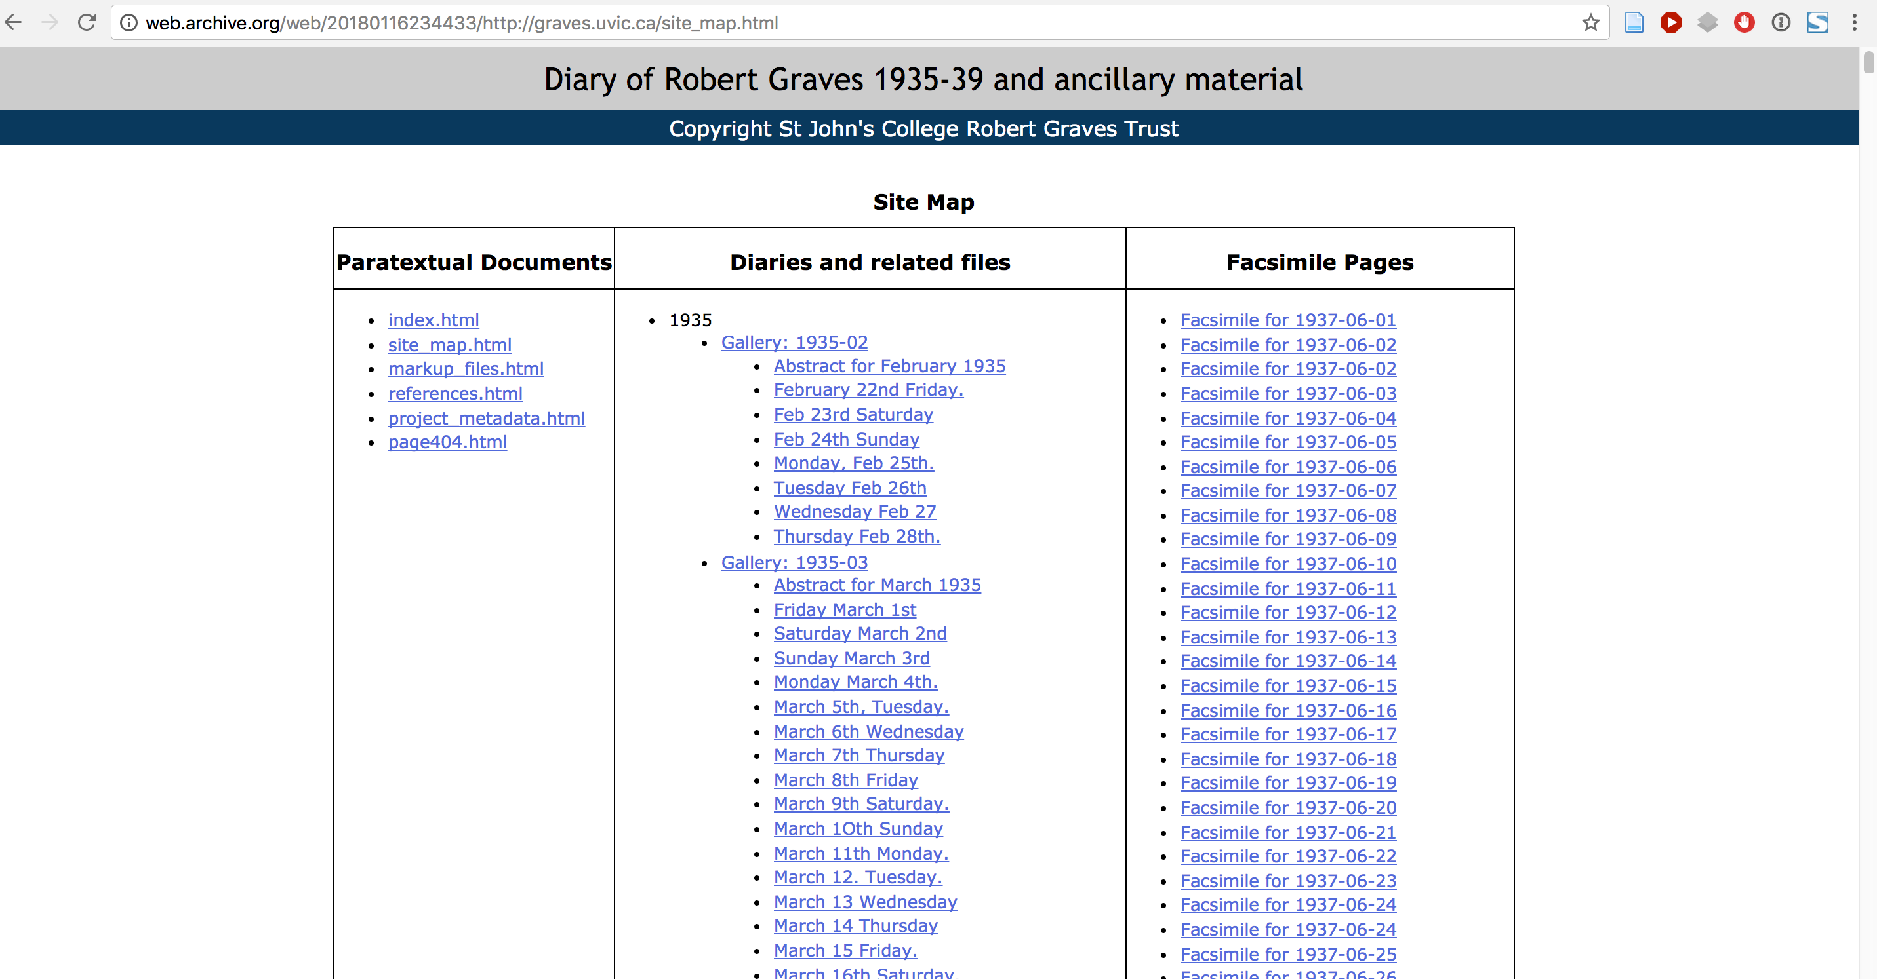
2018 Wayback Site Map (Staticized version)

Slide 29
Project Team
Humanities Researchers
Claire Carlin Ewa Czaykowska-Higgins Janelle Jenstad Elizabeth Grove-White Programming and Technical Collaborators (HCMC) Martin Holmes Stewart Arneil Greg Newton Librarians & Archivists (UVIC) John Durno Lisa Goddard Matt Huculak
Research Assistants Sarah Kell Tye Landels Jennifer Polack Joseph Takeda

